Slide 1


Using VTK-m
In Situ Visualization and Analysis with Ascent
Kenneth Moreland Sandia National Laboratories
ECP Annual Meeting January 17, 2019
Sandia National Laboratories is a multi-mission laboratory managed and operated by National Technology and Engineering Solutions of Sandia, LLC., a wholly owned subsidiary of Honeywell International, Inc., for the U.S. Department of Energy’s National Nuclear Security Administration under contract DE-NA0003525. SAND NO. 2018-14260 PE

Slide 2


Acknowledgements
This material is based upon work supported by the U.S. Department of Energy, Office of Science, Office of Advanced Scientific Computing Research, under Award Numbers 10-014707, 12-015215, and 14-017566.
This research was supported by the Exascale Computing Project (17-SC-20-SC), a collaborative effort of two U.S. Department of Energy organizations (Office of Science and the National Nuclear Security Administration) responsible for the planning and preparation of a capable exascale ecosystem, including software, applications, hardware, advanced system engineering, and early testbed platforms, in support of the nation’s exascale computing imperative.
Sandia National Laboratories is a multimission laboratory managed and operated by National Technology and Engineering Solutions of Sandia, LLC., a wholly owned subsidiary of Honeywell International, Inc., for the U.S. Department of Energy’s National Nuclear Security Administration under contract DE-NA-0003525.
Thanks to many, many partners in labs, universities, and industry.

Slide 3
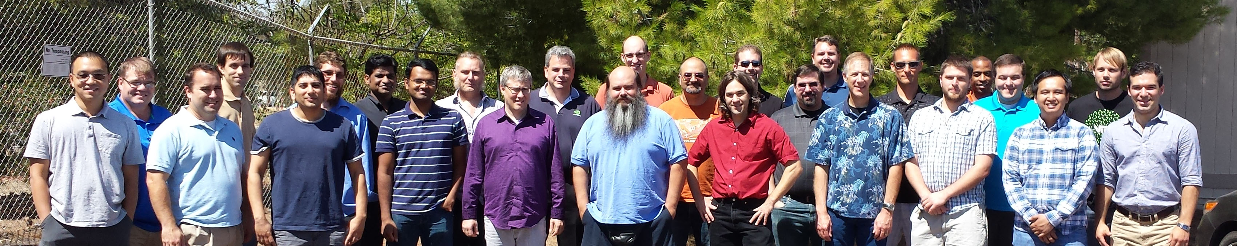
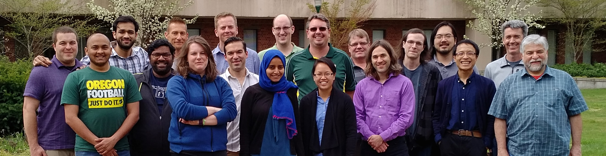
Thanks to All Our Partners!
Code Sprint, September 2015, LLNL
Code Sprint, April 2017, University of Oregon

Slide 4
Why VTK-m?

Slide 5
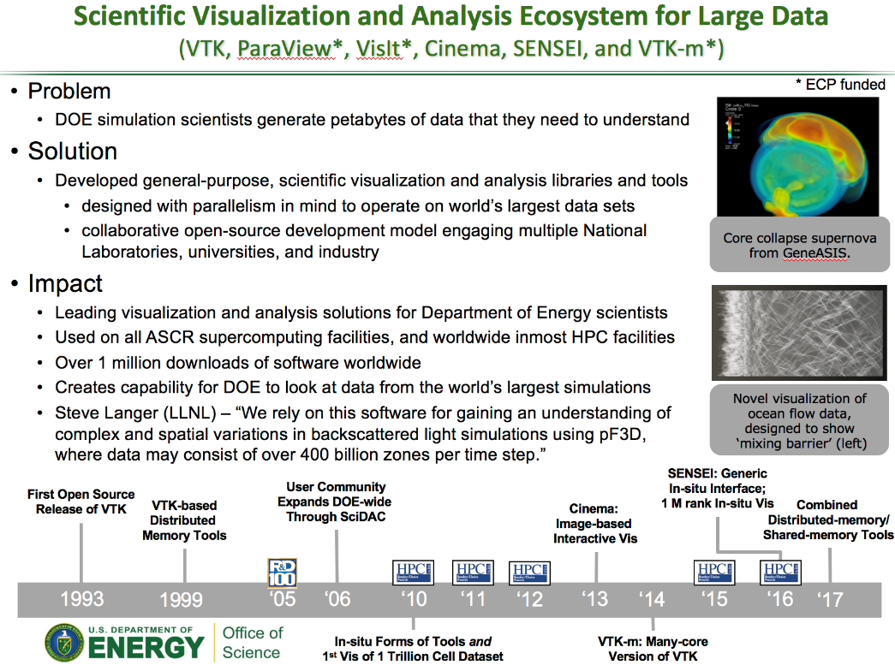
Visualization and Analysis for HPC: Current Status
Developed popular, open source tools (ParaView, VisIt) based on the Visualization ToolKit library (VTK)
Widespread usage in DOE and >1 million downloads worldwide
Hundreds of person years of effort
Two major problems for exascale:
Many-core architectures (as current VTK-based investments are primarily only MPI parallelism)
I/O limitations will require in situ processing
ASCR highlight slide for VTK-based tools.
ECP/VTK-m project focused on problem #1.
ECP ALPINE is focused on problem #2.
Our approaches are complementary and coordinated.

Slide 6
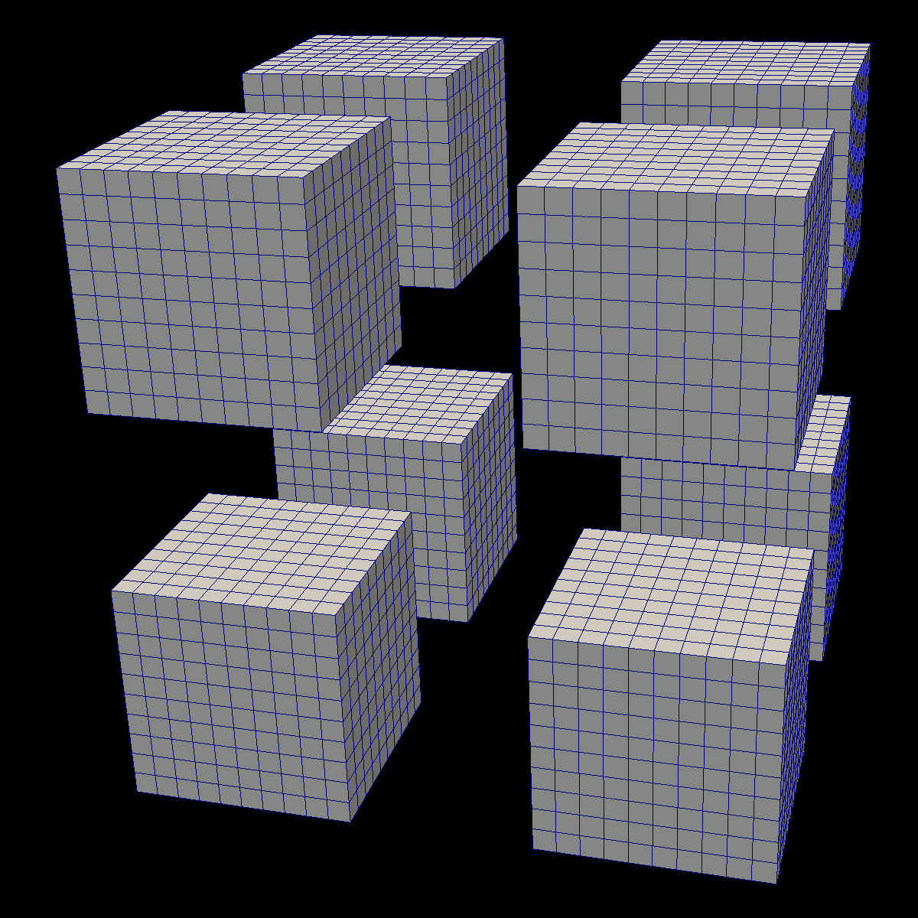
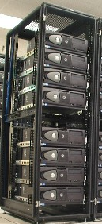



Distributed
Parallelism

Slide 7
Distributed
Parallelism
On Node
Parallelism

Slide 8
VTK-m: the ’m’ is for many-core
VTK:
popular, open source, supported by a community
… but primarily single core only.
VTK-m:
name chosen to evoke the positive attributes of VTK
… but will support multi-core and many-core.
VTK-m is the only DOE effort for many-core visualization.
Previously there were 3 predecessor projects, but the PI’s of those projects decided to join forces in 2014 to make VTK-m.

Slide 9
Isosurface
Streamline
Clip
Render
GPU
CPU
TBB
OpenMP

Slide 10
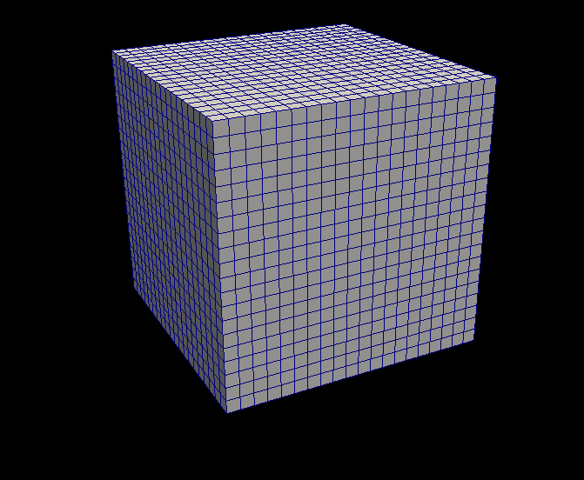
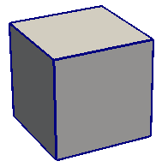
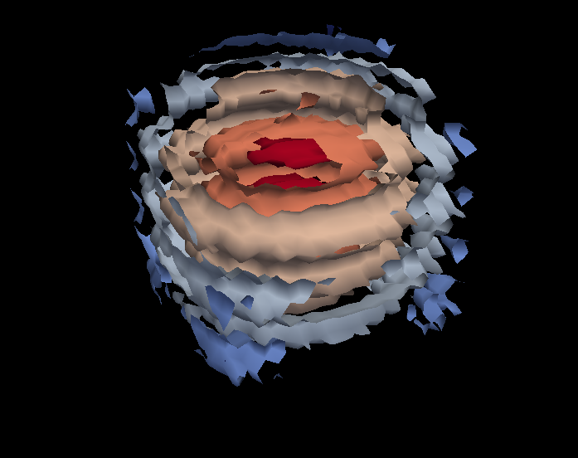
VTK-m Framework
Control Environment
Grid Topology
Array Handle
Invoke
Execution Environment
Cell Operations
Field Operations
Basic Math
Make Cells
Device Adapter
Allocate
Transfer
Schedule
Sort
…
Worklet

Slide 11
How Do I Use VTK-m?

Slide 12
How Do I Use VTK-m?
I use tools like ParaView, VisIt, Catalyst, Libsim, Ascent, etc.
I develop software that uses (or will use) visualization libraries.
I develop visualization software and want to make the leap to many-core devices.

Slide 13
How Do I Use VTK-m?
I use tools like ParaView, VisIt, Catalyst, Libsim, Ascent, etc.

Slide 14
ECP DAV is an integrated workflow
Apps
In situ
Infrastructure
In situ
Algorithms
Output/Artifacts
Post
Processing
ALPINE
ASCENT
New
Algorithms
ParaView
Cinema
VisIt
Libsim
Traditional
Algorithms
Traditional
Output
VisIt
Rendering
…
…
ParaView
Catalyst
Rover
VTKm
VTKm

Slide 15
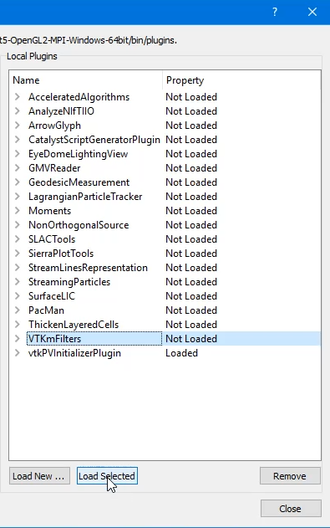
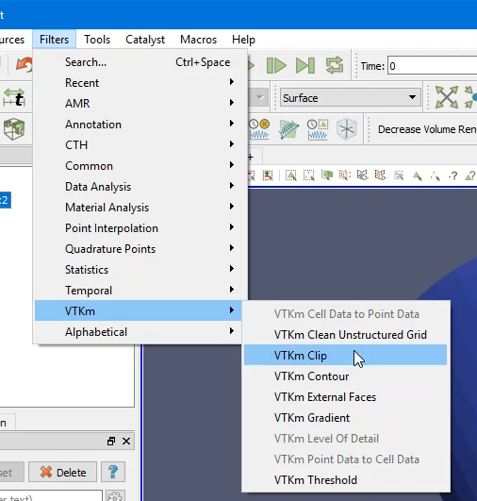
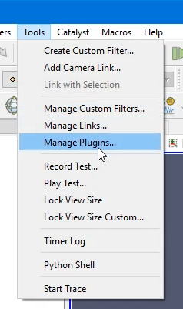
Using VTK-m in ParaView
1. Load VTK-m Plugin
2. Use a VTK-m filter like any other

Slide 16
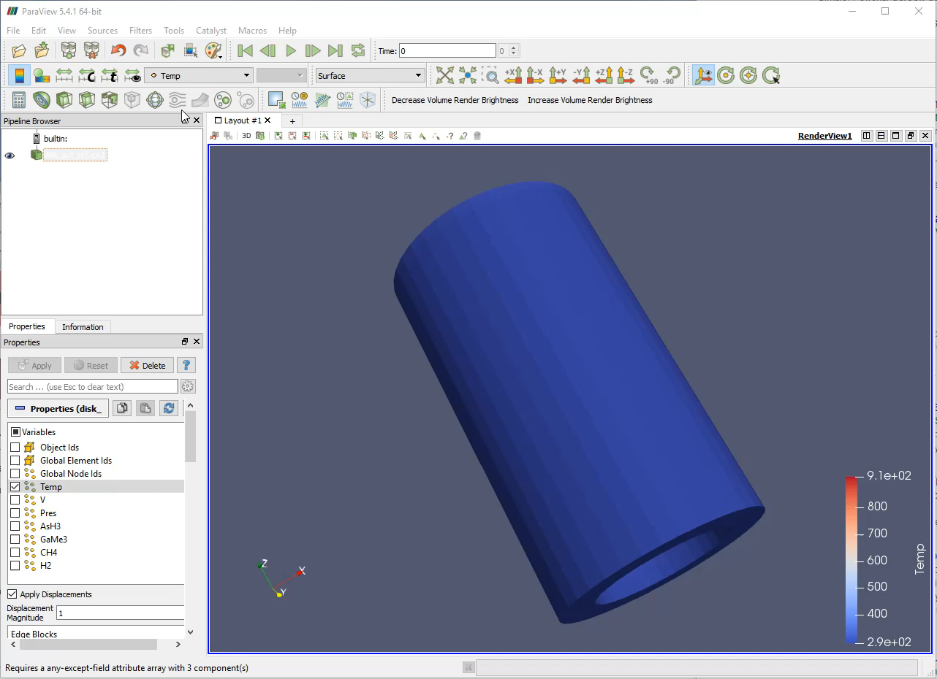

Slide 17
Using VTK-m in VisIt
1. Turn on VTK-m in Preferences
2. Use VTK-m-enabled plots as normal

Slide 18
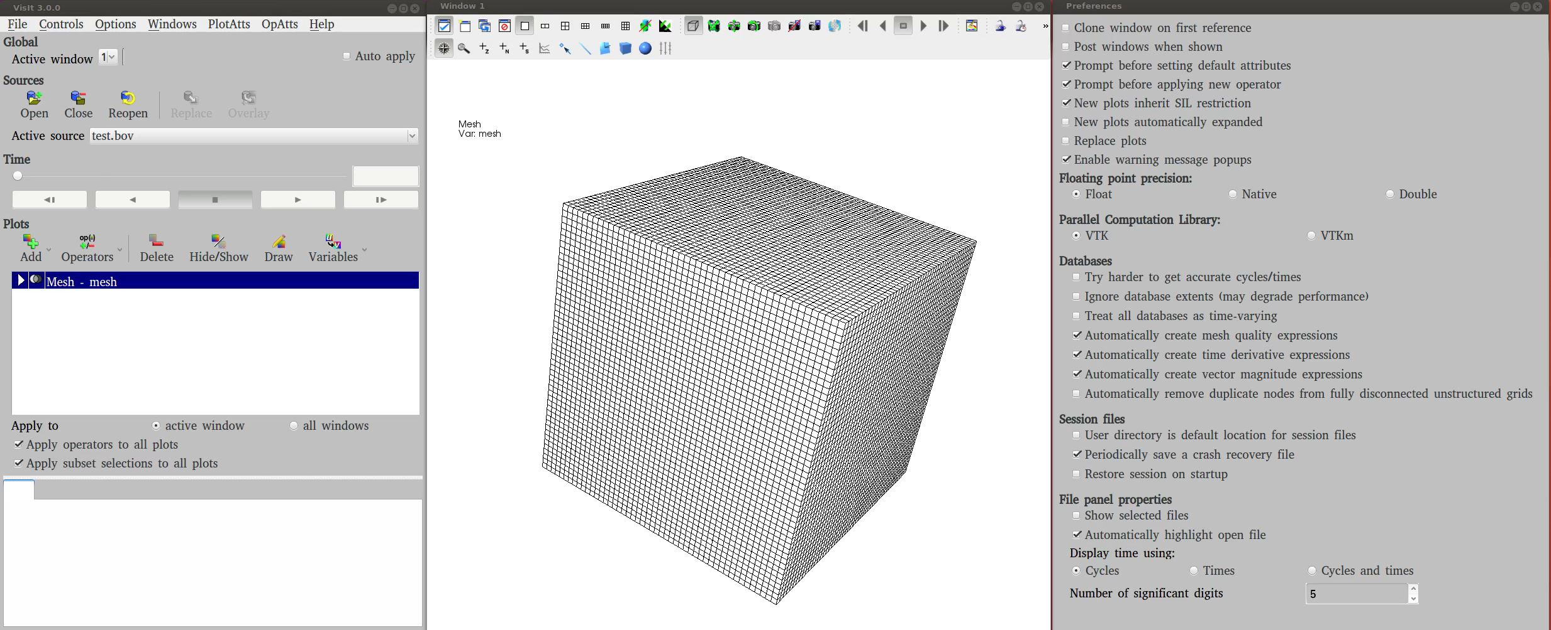

Slide 19
How Do I Use VTK-m?
I develop software that uses (or will use) visualization libraries.

Slide 20
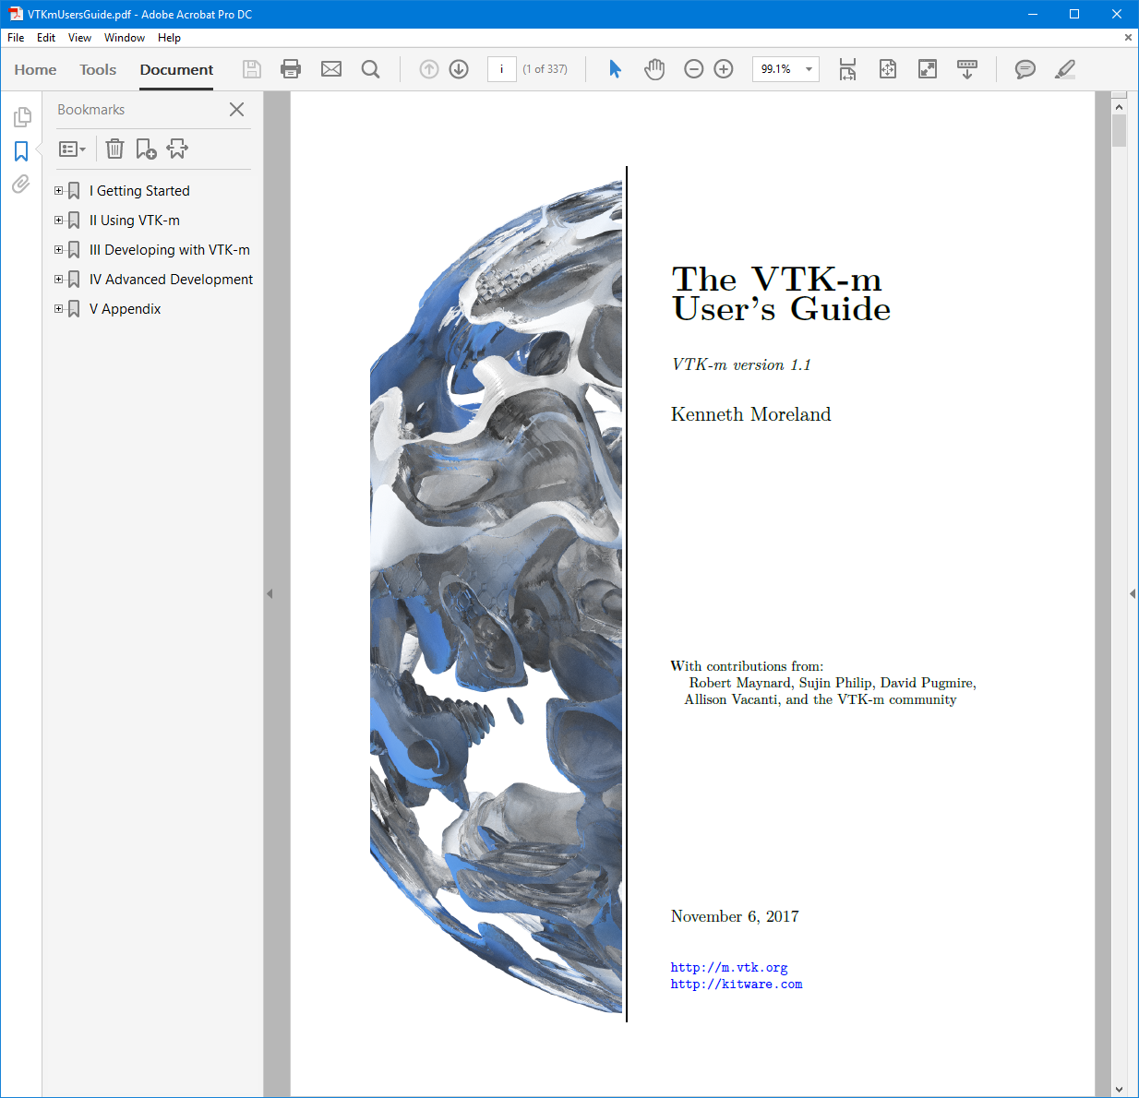

Slide 21

Using VTK-m: Reading Files

Slide 22
Using VTK-m in Ascent
void MyAscentFilter::execute()
{
vtkh::DataSet *input_data = this->input<vtkh::DataSet>(0);
vtkh::DataSet *output_data = new vtkh::DataSet;
for (int index = 0; index < input_data->GetNumberOfDomains(); ++index)
{
vtkm::Id domain_id;
vtkm::cont::DataSet input_domain;
input_data->GetDomain(index, input_domain, domain_id);
// Do something interesting with input_domain.
output_data->AddDomain(output_domain, domain_id);
}
this->set_output<vtkh::DataSet>(output_data);
}

Slide 23
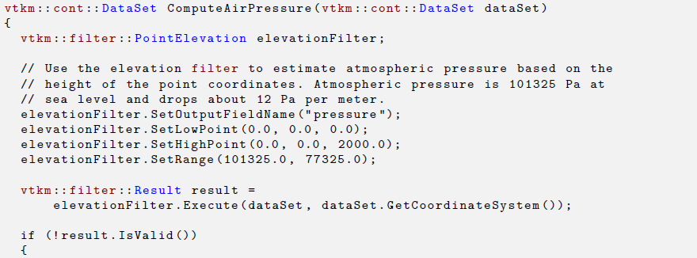

Using VTK-m: Running Filters

Slide 24
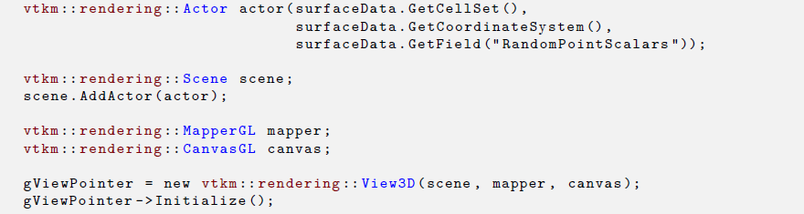
Using VTK-m: Rendering

Slide 25
How Do I Use VTK-m?
I develop visualization software and want to make the leap to many-core devices.

Slide 26
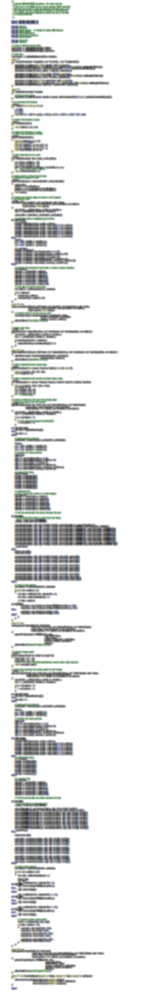

VTK-m
283 Lines
CUDA SDK
561 Lines
Notes:
The source code of Marching Cubes in three different packages. Case tables removed (all essentially the same).
CUDA SDK: marchingCubes_kernel.cu
VTK-m: IsosurfaceUniformGrid.h

Slide 27
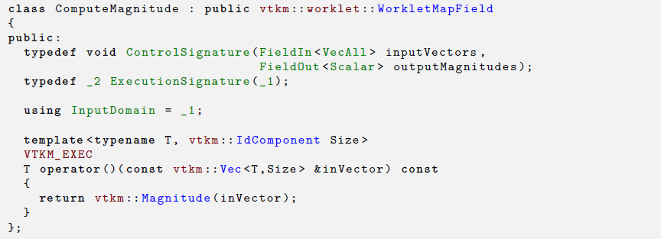

Slide 29
Conclusion
Let us know what further help you would like
Do you want a more focused, more in depth tutorial?
Let us know how to prioritize our development
Is there something in particular you do a lot with ParaView, VisIt, Catalyst, Libsim, ASCENT, etc.?
Is there something that seems to be running slower in ParaView, VisIt, Catalyst, Libsim, ASCENT, etc.?
Is there functionality missing from ParaView, VisIt, Catalyst, Libsim, ASCENT, etc.?

